Slide 1
2022-10-07
Array manipulation
Passing array to function
Practice test
Presenter: Nguyen Khoa

Slide 2
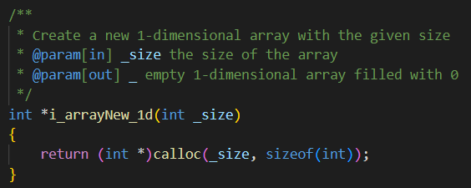
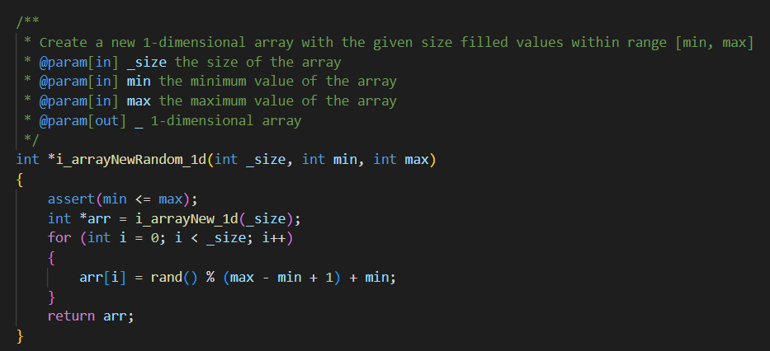

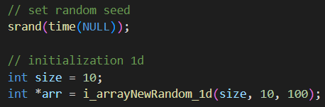
1.1. Array iNITIALIZATION
Note:
MUST HAVE #include <stdlib.h>
Note:
MUST HAVE #include <assert.h>
Note:
May need #include <time.h>
srand(time(NULL));

Slide 3
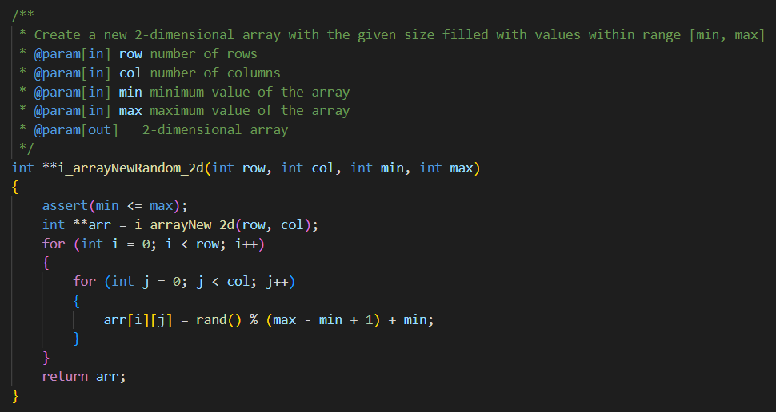
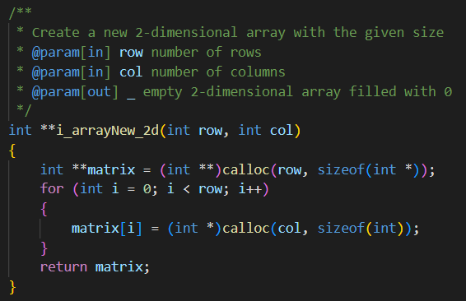
1.1. Array iNITIALIZATION
Note:
MUST HAVE #include <assert.h>
Note:
MUST HAVE #include <stdlib.h>
Note:
May need #include <time.h>
srand(time(NULL));

Slide 4
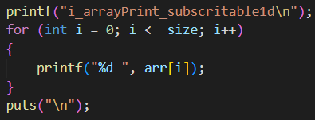
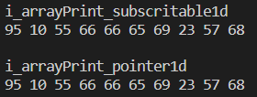
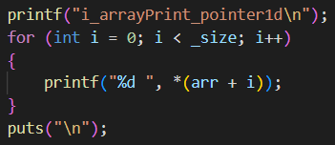
1.2. accessing elements
of an Array

Slide 5
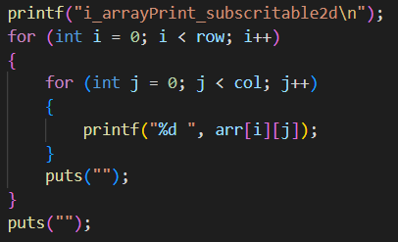
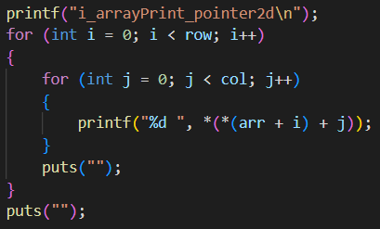
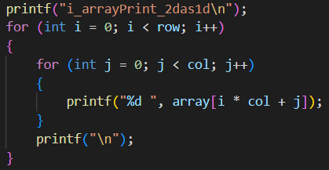
1.2. accessing elements
of an Array

Slide 6
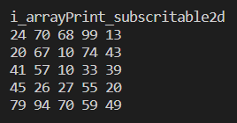
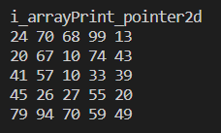
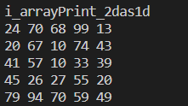
1.2. accessing elements
of an Array

Slide 7
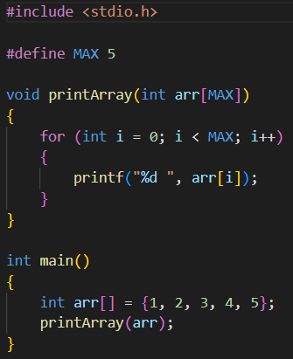
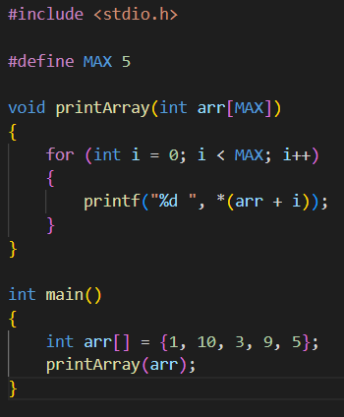
2.1. Passing 1-dimetional
array to function

Slide 8
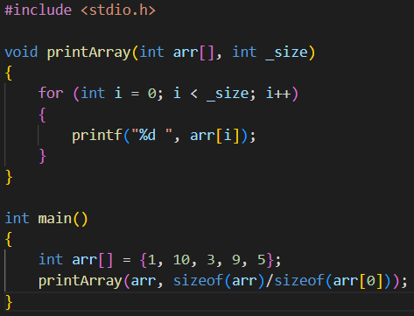
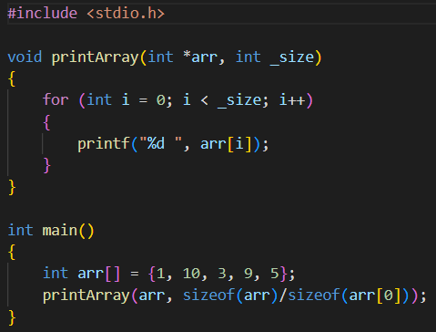
2.1. Passing 1-dimetional
array to function

Slide 9
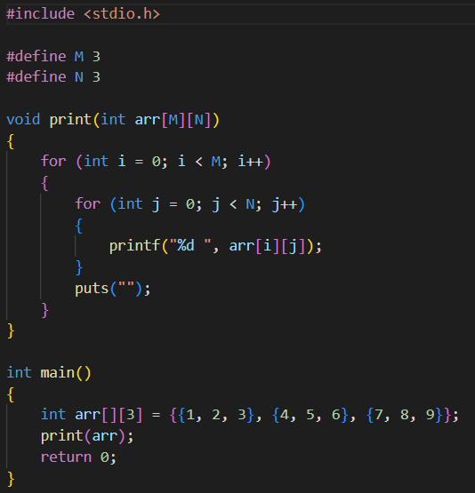
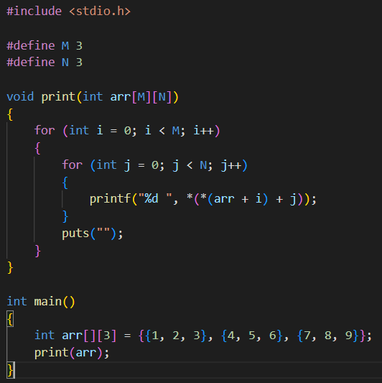
2.2. Passing 2-dimetional
array to function

Slide 10
2.2. Passing 2-dimetional
array to function

Slide 11
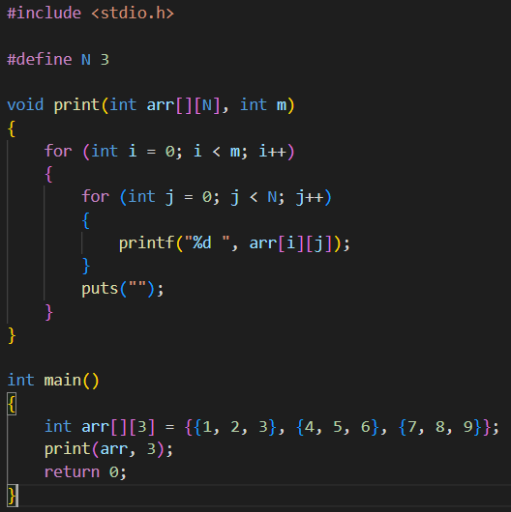
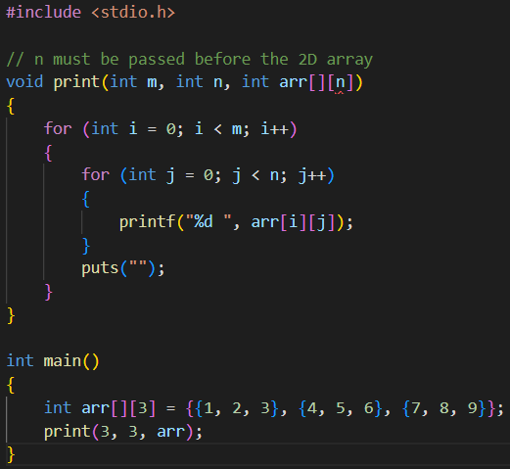
2.2. Passing 2-dimetional
array to function

Slide 12
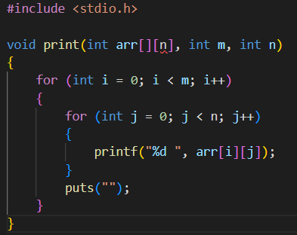
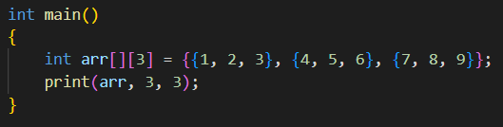
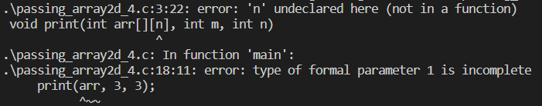
2.2. Passing 2-dimetional
array to function

Slide 13
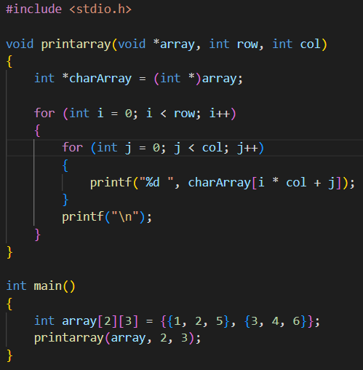
2.2. Passing 2-dimetional
array to function

Slide 14
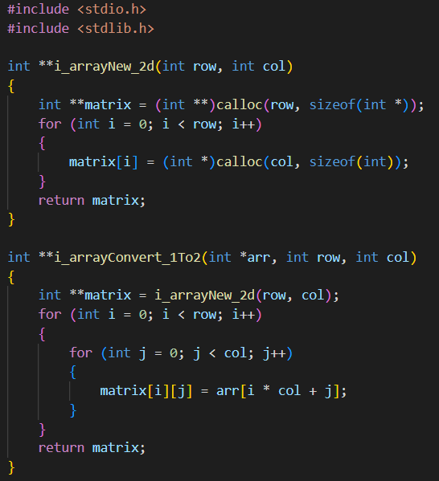
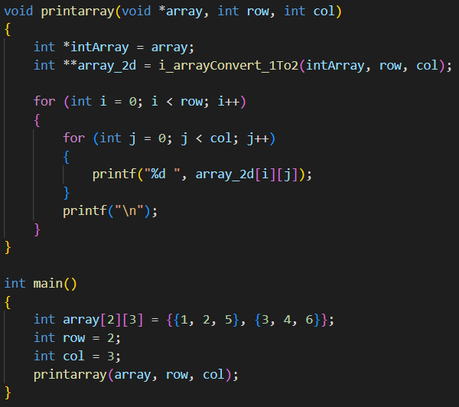
2.2. Passing 2-dimetional
array to function

Slide 15
2.2. Passing 2-dimetional
array to function

Slide 16
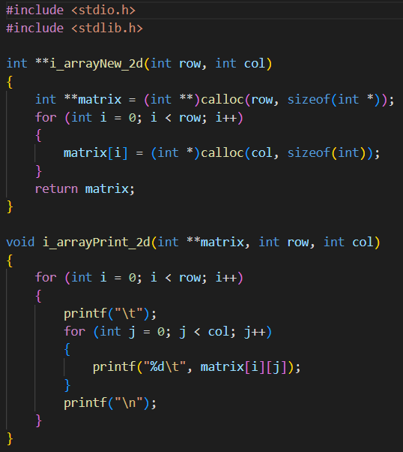
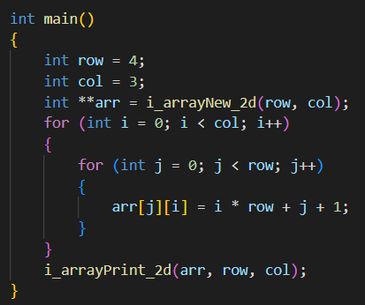

2.2. Passing 2-dimetional
array to function

Slide 17
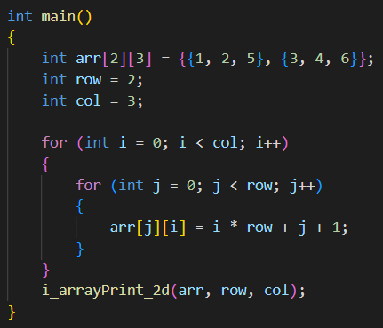
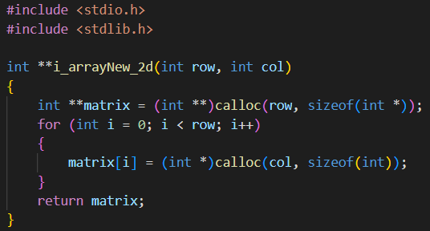
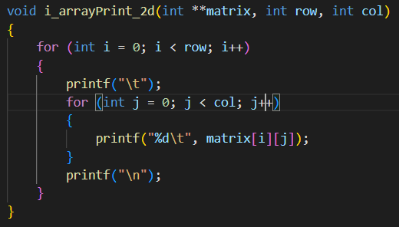
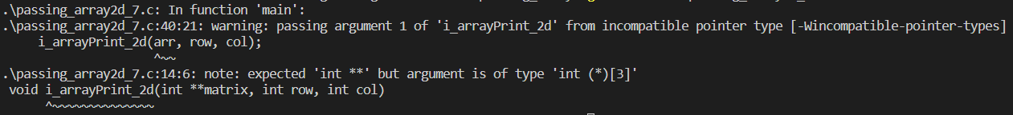
2.2. Passing 2-dimetional
array to function

Slide 18
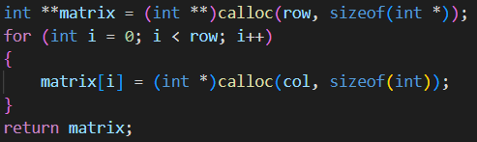
summary
1-Dimensional Array Allocation
2-Dimensional Array Allocation
Accessing Element 1-Dimensional Array
Other
1. int matrix[n][m] is not a double pointer
2. When passing an array to function, the thing that is actually passed is the address of the first element of the array (aka pointer)
Accessing Element 2-Dimensional Array

Slide 19



summary
Passing a 1-dimentional array to function
Passing a 2-dimentional array to function

Slide 20
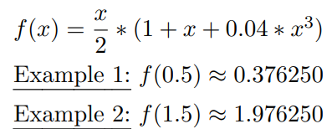
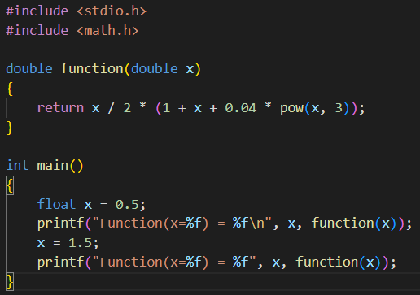

3. Practice test
1.1.

Slide 21
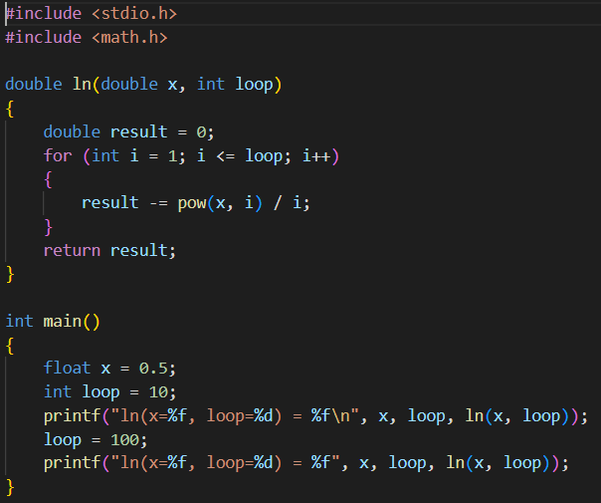

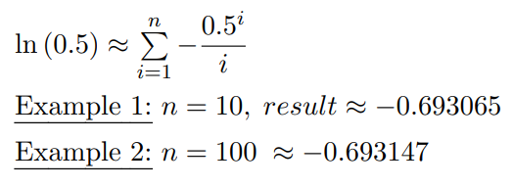

3. Practice test
1.2.

Slide 22
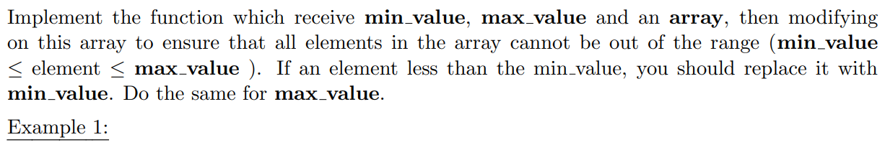
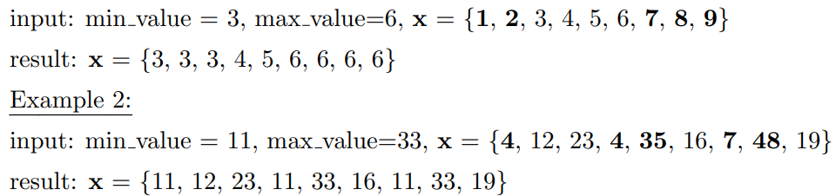
3. Practice test
2.1.

Slide 23
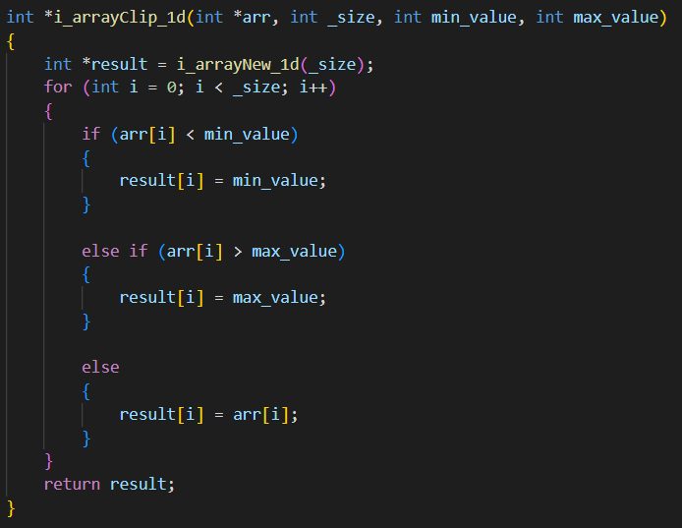
3. Practice test
2.1.

Slide 24
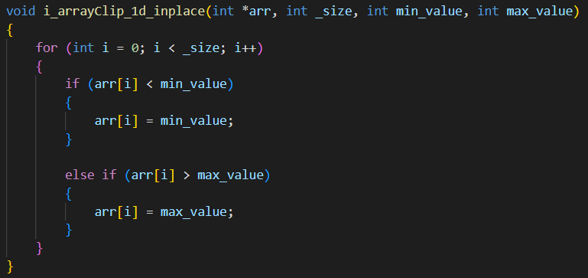
3. Practice test
2.1.

Slide 25
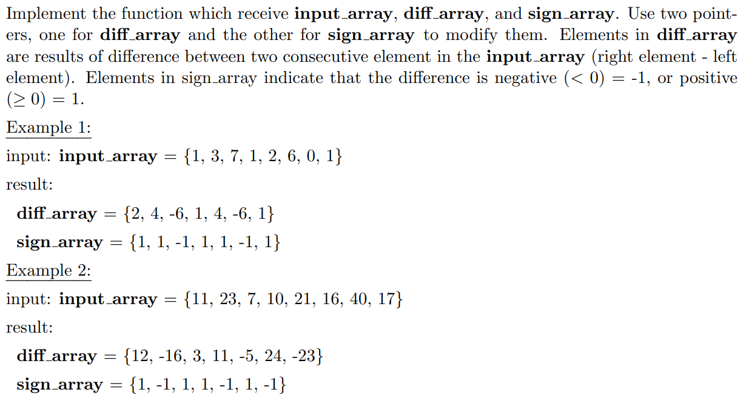
3. Practice test
2.2.

Slide 26
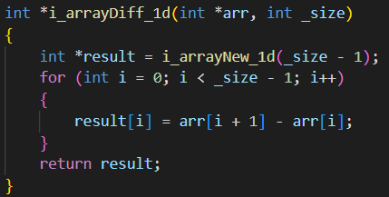
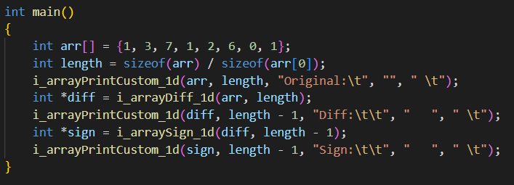
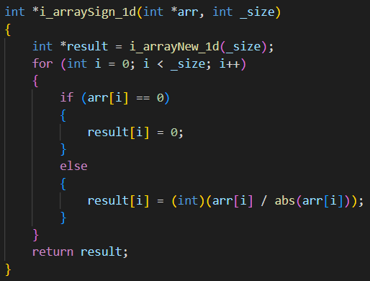
3. Practice test
2.2.

Slide 27
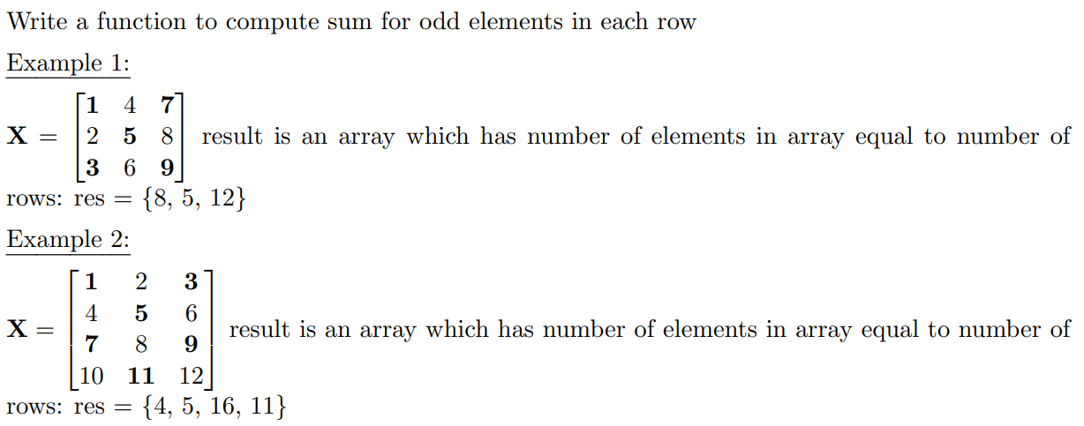
3. Practice test
3.1.

Slide 28
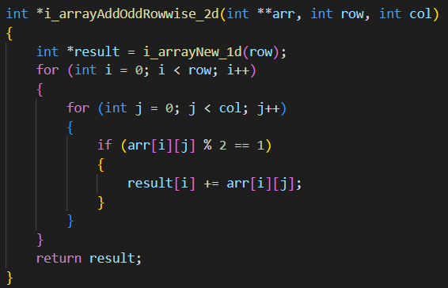
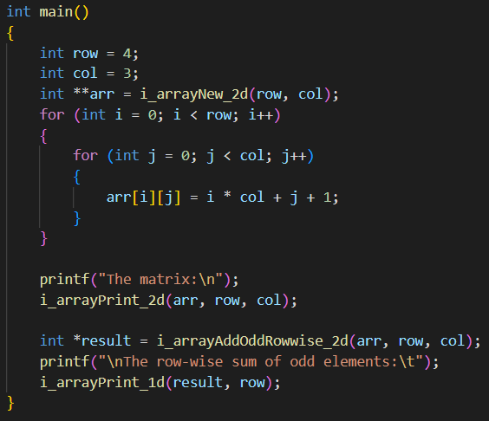

3. Practice test
3.1.

Slide 29

3. Practice test
3.2.

Slide 30



3. Practice test
3.2.

Slide 31

3. Practice test
4.1.

Slide 32



3. Practice test
4.1.

Slide 33

3. Practice test
4.2.

Slide 34



3. Practice test
4.2.

Slide 35
Thank you for listening

